Slide 1
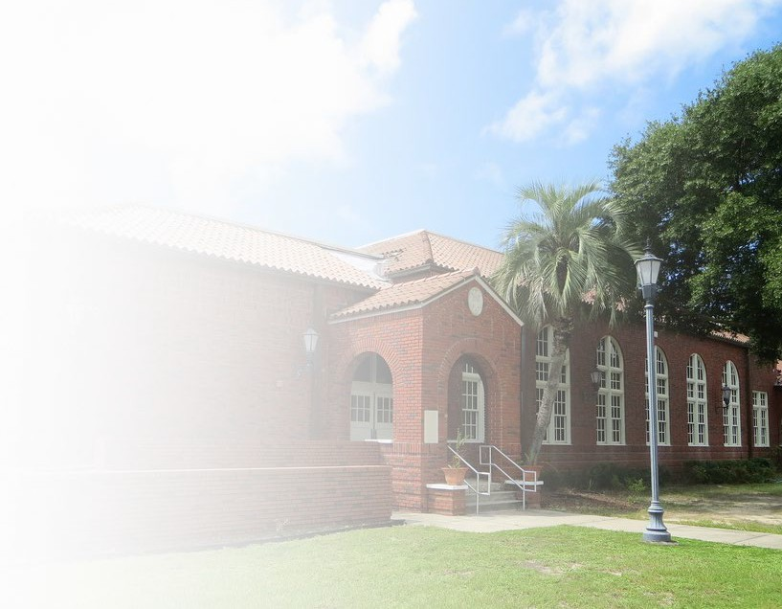
DESTINATION PANAMA CITY
St. Andrews School Property
Cultural Tourism Opportunities and Recommendations
October 12, 2021
Prepared by:
Robin Malpass & Associates, Inc.
Chicago, IL 60611
(312) 626-2915
Robinmalpass.com

Slide 2
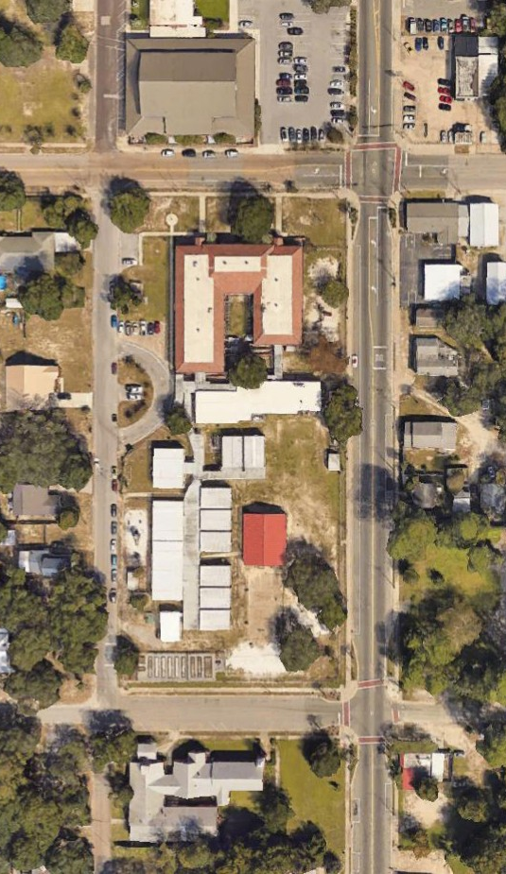
PROJECT BACKGROUND
In 2015, we completed a cultural tourism destination review for the Panama City Tourism Study, which concluded that there was a need for a DMO to represent Panama City, Florida as a tourism destination.
In 2021, the DMO “Destination Panama City” has requested our assistance in formulating recommendations for the City’s consideration on how to reimagine the St. Andrews School property as a new cultural tourism anchor.
St. Andrews School Property • Cultural Tourism Opportunities and Recommendations

Slide 3
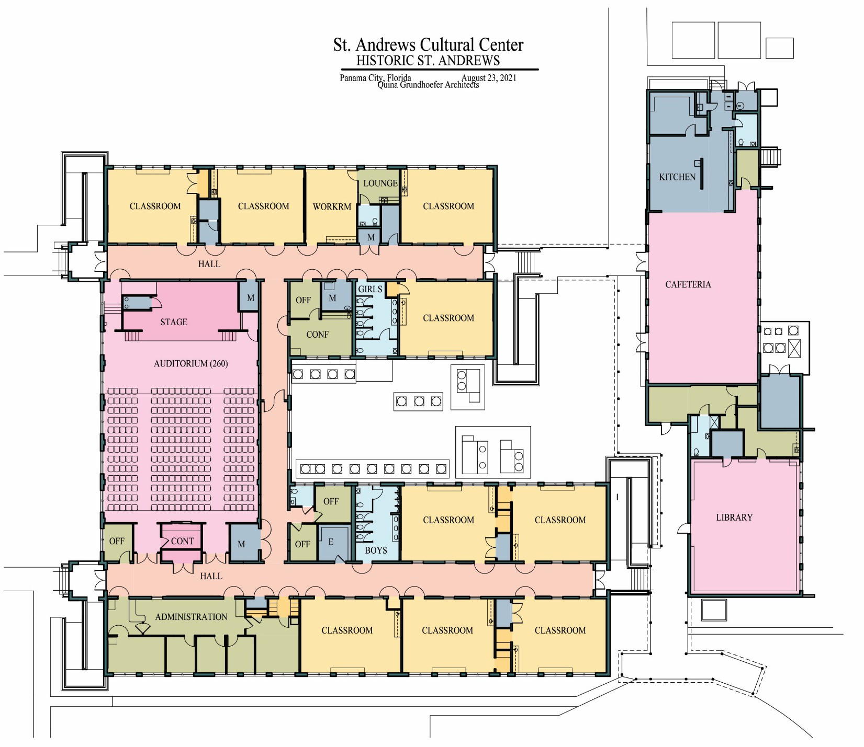
METHODOLOGY
Robin Malpass & Associates aspires to access the opportunities in a constructive process that encourages open and honest communication among stakeholders with the desired result of establishing a unified shared vision for success.
St. Andrews School Property • Cultural Tourism Opportunities and Recommendations

Slide 4
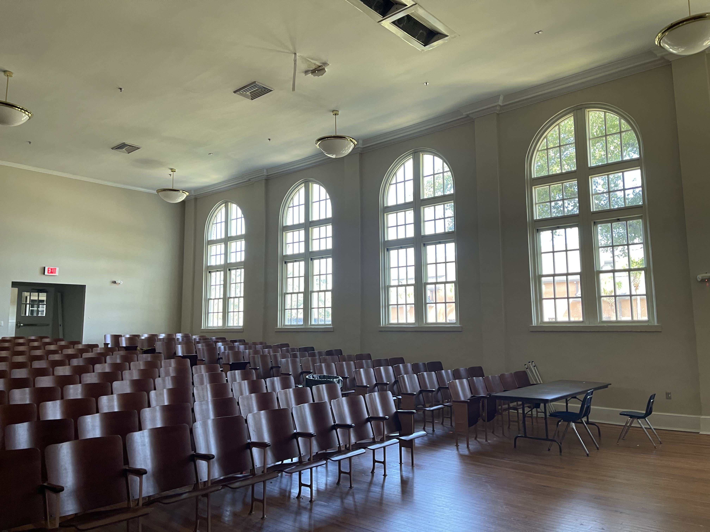
REIMAGINATION GOALS
Drive increased visitation to the destination - specifically by cultural tourists, as they represent a demographic that stays longer and spends more.
Maximize cultural experiences that the local community and visitors can participate in equally.
Include revenue opportunities to foster self-supporting structure.
Foster economic opportunities for local businesses and cultural tourism.
St. Andrews School Property • Cultural Tourism Opportunities and Recommendations

Slide 5
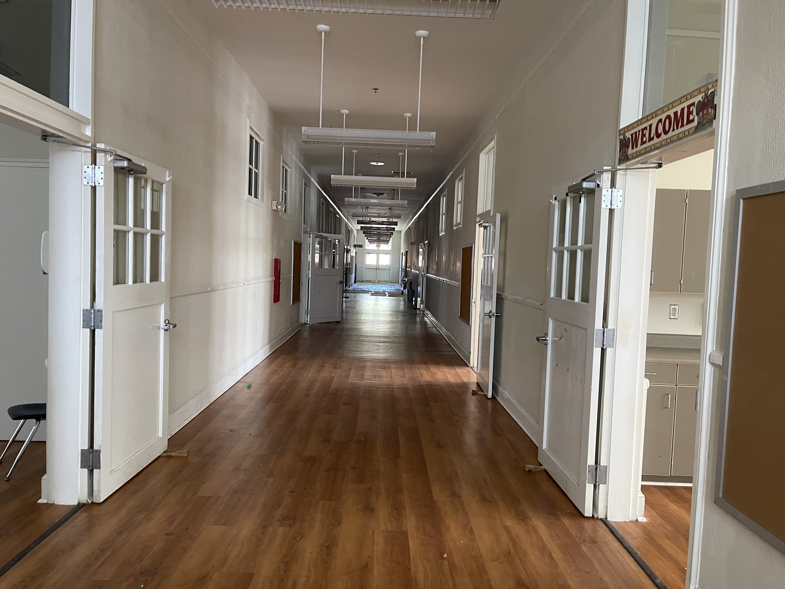
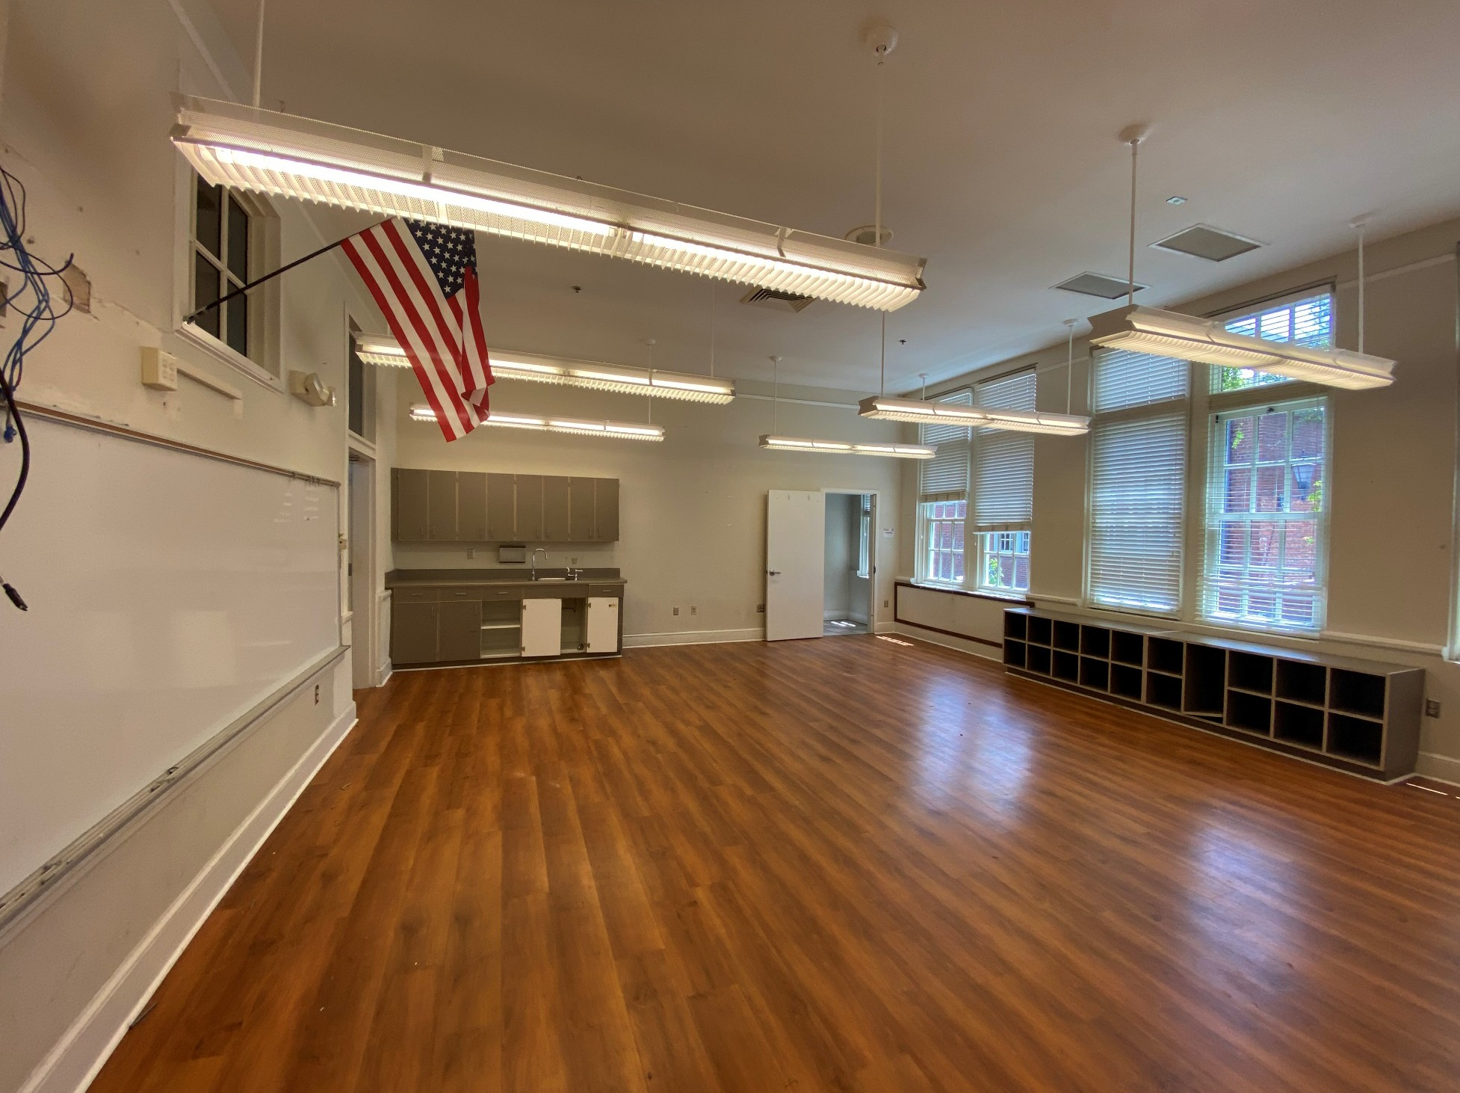
THE PROCESS
Evaluation of existing facilities
- Toured site
- Architect consultation
Note: In the 2015 cultural destination tourism review it was noted that in Panama City, the St. Andrews neighborhood is well positioned for cultural tourism.
Interview stakeholders
- City of Panama City
- Destination Panama City
- Community Input Sessions (organizations and individuals)
Identify common shared vision components
- Tourism
- Community
- Self-supporting
- Preservation
- History/Heritage
St. Andrews School Property • Cultural Tourism Opportunities and Recommendations

Slide 6
THE PROCESS
Art & Cultural SWOT Analysis
Strengths, Weaknesses, Opportunities, Threats
SWOT Highlights
Talent, expertise (Characteristic of the destination)
Facility
DMO
Supporting tourism assets
St. Andrews School Property • Cultural Tourism Opportunities and Recommendations

Slide 7
SWOT Opportunities
New Audiences - Creative Tourism
Creative (Cultural) Tourism
Creative Tourism is a sub-form of Cultural Tourism that was introduced in 2000 by Greg Richards and Crispin Raymond. They defined it as “Tourism which offers visitors the opportunity to develop their creative potential through active participation in experiences which are characteristic of the destination.”
In 2004, UNESCO recognized this new form of tourism by launching the Creative Cities Network. Today, this is a thriving cultural tourism segment that can be found around the world. The St. Andrews School property provides an opportunity for Destination Panama City to more fully engage in this new tourism market segment.
St. Andrews School Property • Cultural Tourism Opportunities and Recommendations

Slide 8
SWOT Opportunities
UNESCO Creative Cities of Media Arts (17 total)
Austin, TX
Toronto
Amsterdam Light Festival (10 years)
Chicago Art on the Mart (4 years)
Panama City Public Eye Soar (8 years)
Florida - Leader in Media Arts Education
#2 Full Sail
#9 FSU
St. Andrews School Property • Cultural Tourism Opportunities and Recommendations

Slide 9
SWOT Opportunities
Immersive Art Experiences - Immersive Van Gogh Exhibit
St. Andrews School Property • Cultural Tourism Opportunities and Recommendations

Slide 10
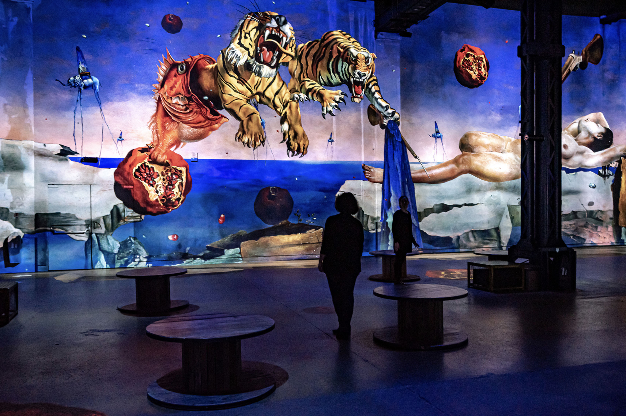
SWOT Opportunities
Immersive Art Experiences - Dalí, the endless enigma
St. Andrews School Property • Cultural Tourism Opportunities and Recommendations

Slide 11
SWOT Opportunities
Immersive Art Experiences - Yayoi Kusama, Infinity Mirror Rooms
St. Andrews School Property • Cultural Tourism Opportunities and Recommendations

Slide 12
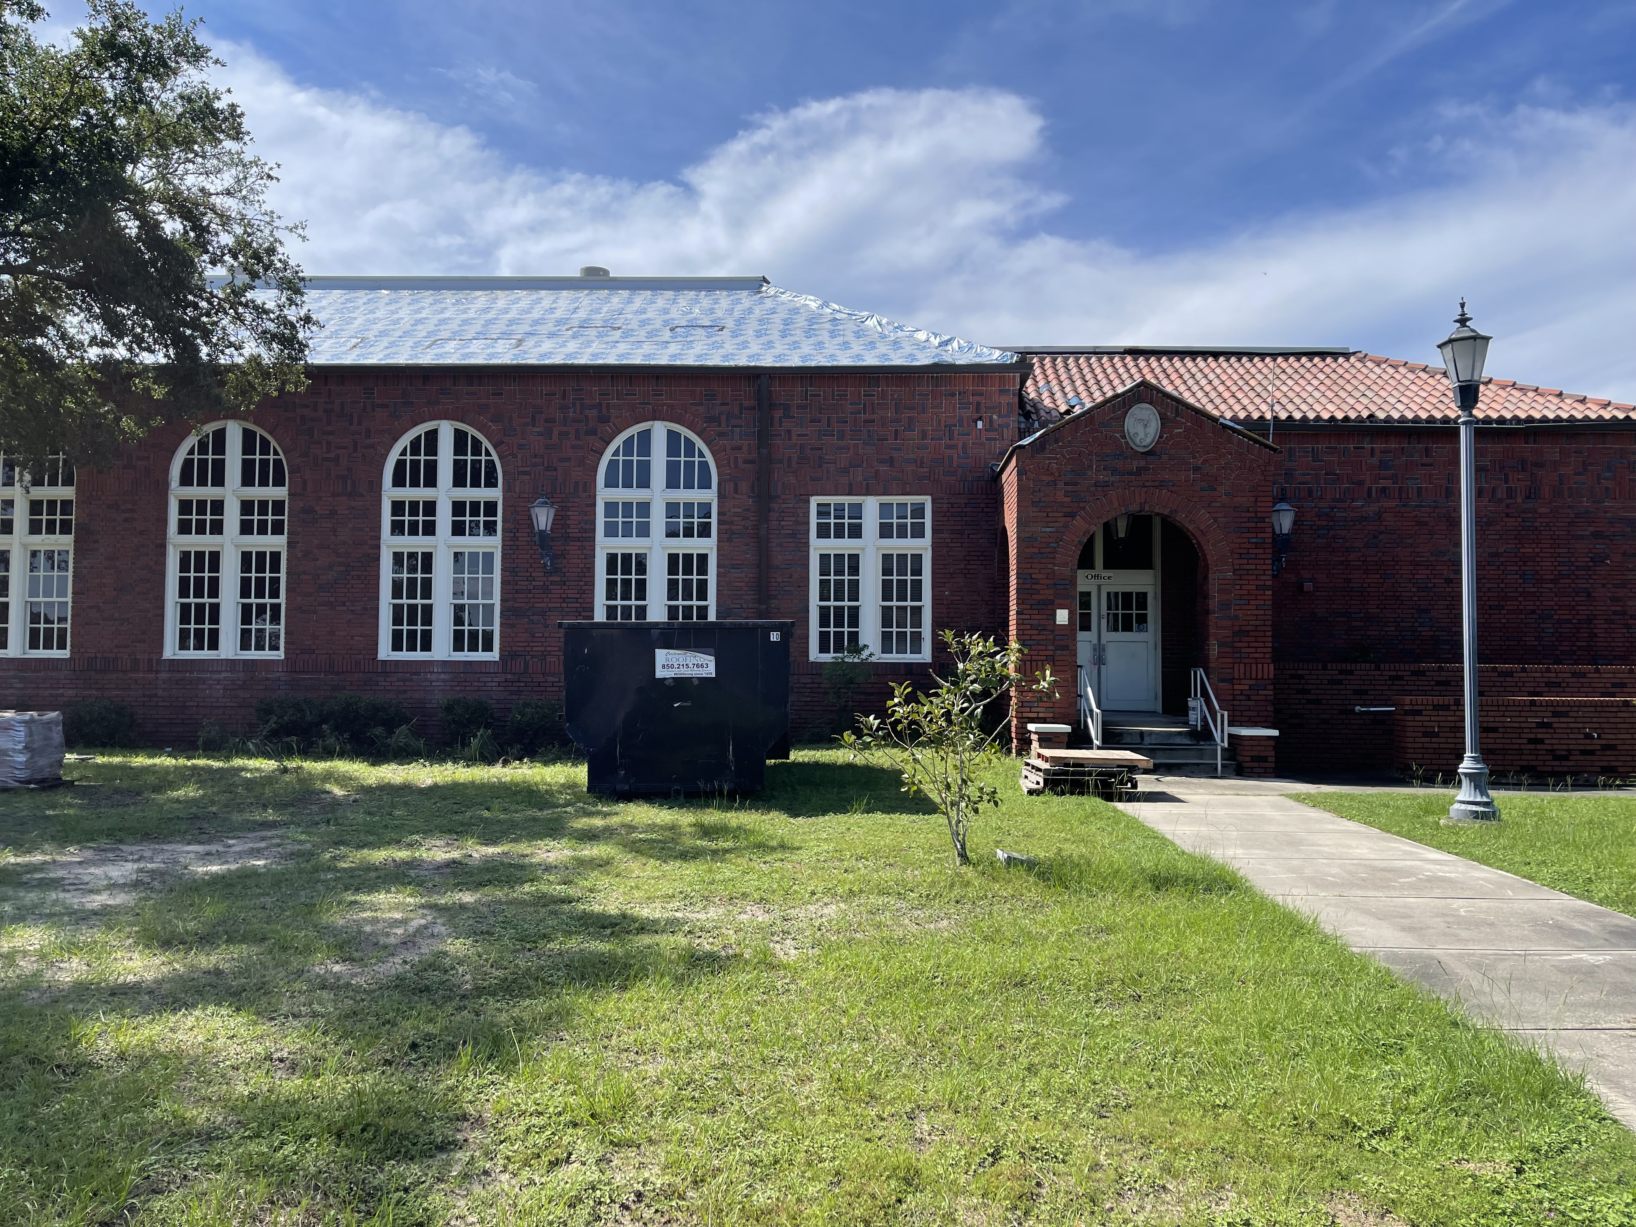
THE POSSIBILITIES
St. Andrews School Property • Cultural Tourism Opportunities and Recommendations

Slide 13
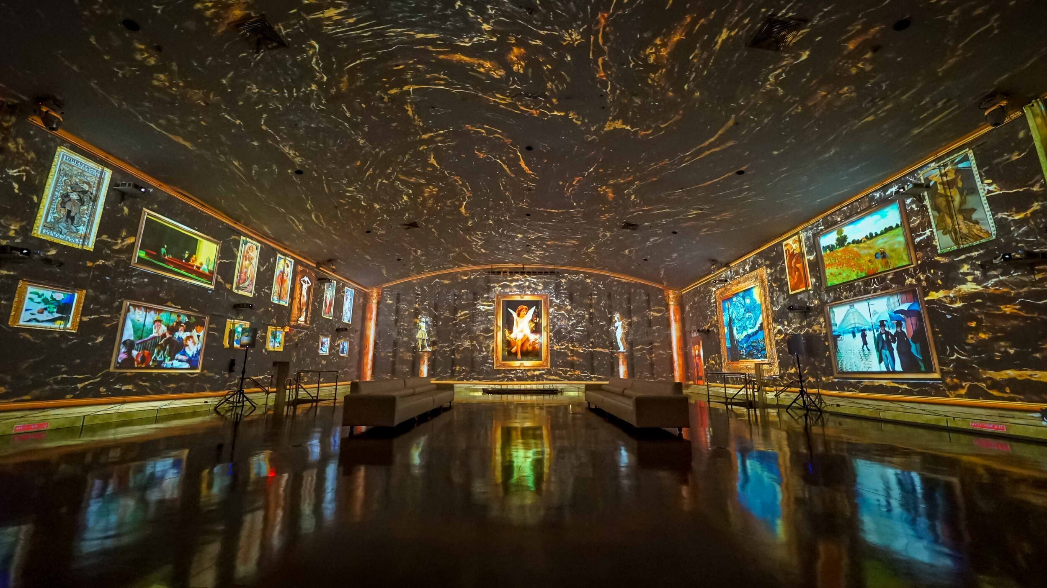
THE POSSIBILITIES
St. Andrews School Property • Cultural Tourism Opportunities and Recommendations

Slide 14
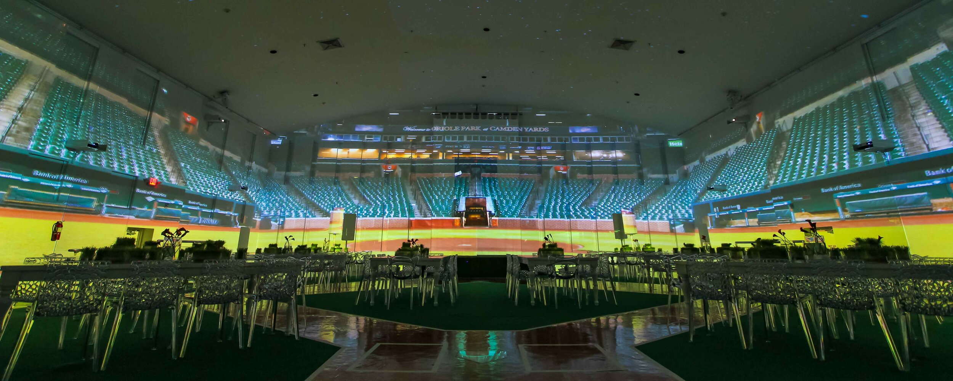
THE POSSIBILITIES
St. Andrews School Property • Cultural Tourism Opportunities and Recommendations

Slide 15
THE POSSIBILITIES
St. Andrews School Property • Cultural Tourism Opportunities and Recommendations

Slide 16
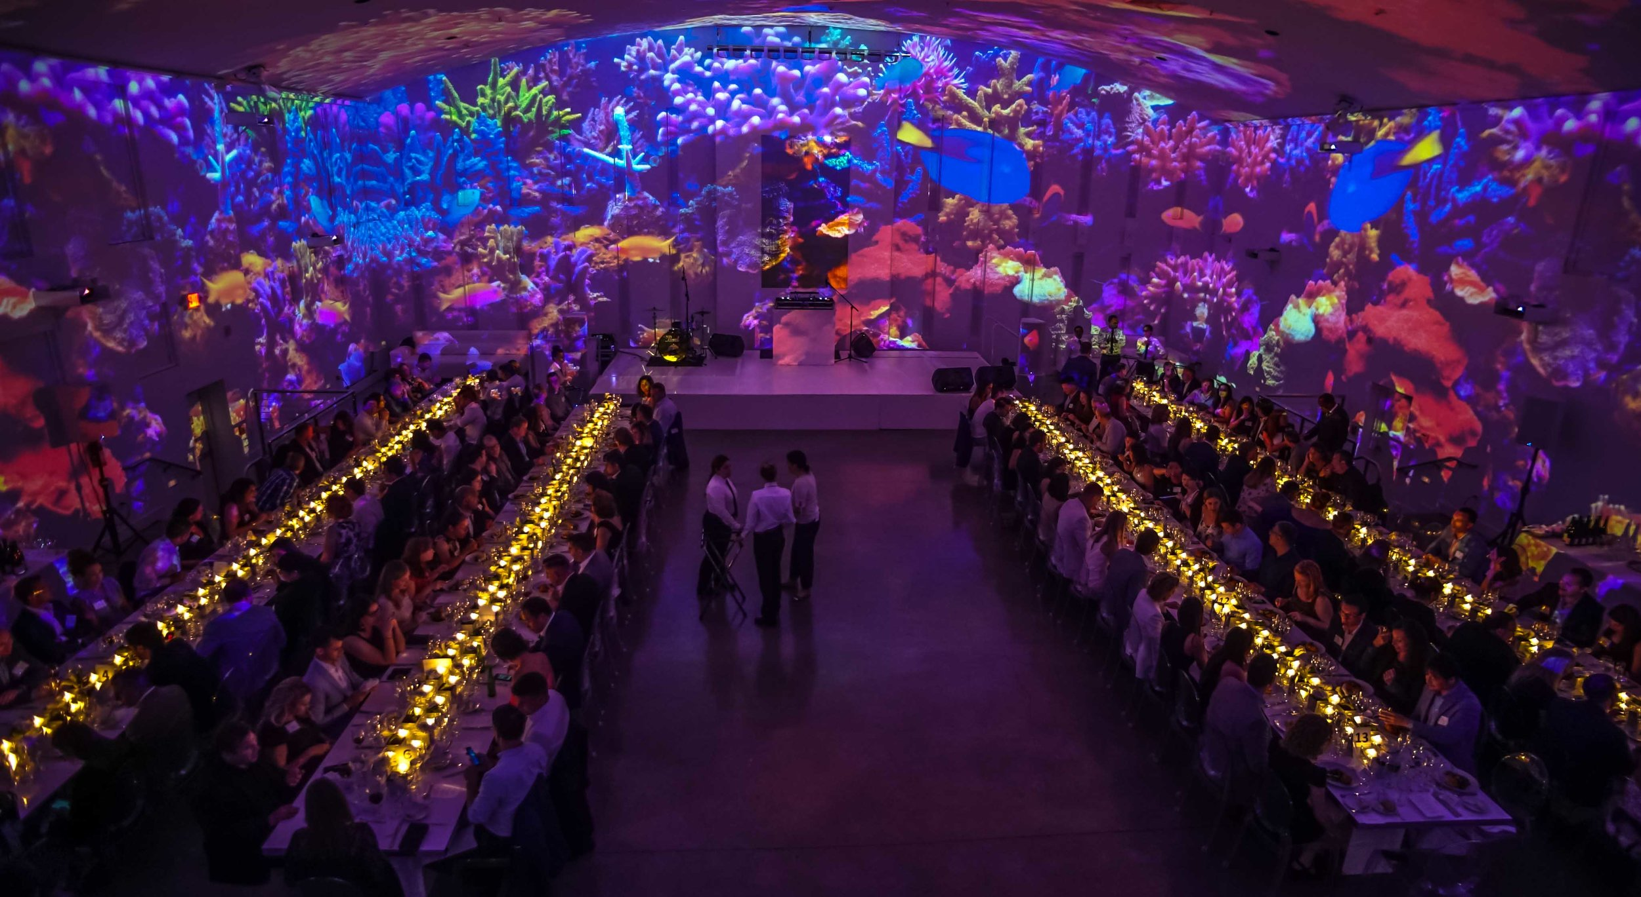
THE POSSIBILITIES
St. Andrews School Property • Cultural Tourism Opportunities and Recommendations

Slide 17
THE POSSIBILITIES
New Brand Characteristics
Immersive Cultural Experiences
Self-supporting Revenue Streams
Arts & Cultural District (critical mass)
St. Andrews School Property • Cultural Tourism Opportunities and Recommendations

Slide 18
THE POSSIBILITIES
Innovation – Technology – Creativity
Unlimited Exhibitions
Workshops / Maker Space
Events
Outdoor Sculpture Garden
Lectures
Performances
Storytelling
New and Expanded Festivals
International Tourism Designations
St. Andrews School Property • Cultural Tourism Opportunities and Recommendations

Slide 19
NEXT STEPS
Facilities Review
Technology Review
Organization & Staffing Models
Budget & Revenue Projections
Grants & Funding Sources
St. Andrews School Property • Cultural Tourism Opportunities and Recommendations

Slide 20
FINALIZE RECOMMENDATIONS
Receive Feedback
Make Adjustments
Finalize by 10/31/2021
St. Andrews School Property • Cultural Tourism Opportunities and Recommendations

Slide 21
Questions?
Robin@RobinMalpass.com
312-508-0228
St. Andrews School Property • Cultural Tourism Opportunities and Recommendations

